Slide 1
Open Optical Network project presentation
Renato Ambrosone
S279186

Slide 2
Aim of the project
SIMULATE A NETWORK WITH TRANSPARENT LIGHTPATH ALLOCATION: Inside the code, we receive as input a network topology description and a traffic matrix (explained later): through a montacarlo analysis we want to estimate the main metrics.
SHOW THE POTENTIAL OF DIGITAL TWIN The software is coded the full emulate the behavior of an optical network including ROADM, Links, Amplifiers, Transceivers, Links, Signal …

Slide 3
1. Project Structure

Slide 4
Classes
Main.py
Network.py
Node.py
Line.py
Connection.py
SignalInformation.py
LightPath.py

Slide 5
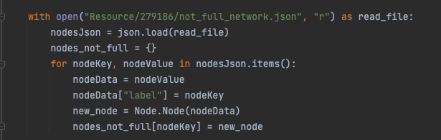
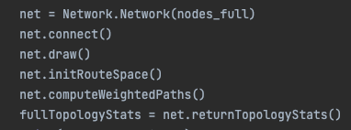
Main
Read topology from file
Instantiate network and creates traffic matrix
Run simulation and collect metrics

Slide 6
Classes
Main.py
Network.py
Node.py
Line.py
Connection.py
SignalInformation.py
LightPath.py

Slide 7
Network.js
This class implements most of the logic. It receives the network description as python dict.
Inside the _init_ method, all nodes and lines objects are created.
From the external you can also call returnTopologyStats() that returns the main topology stats.

Slide 8
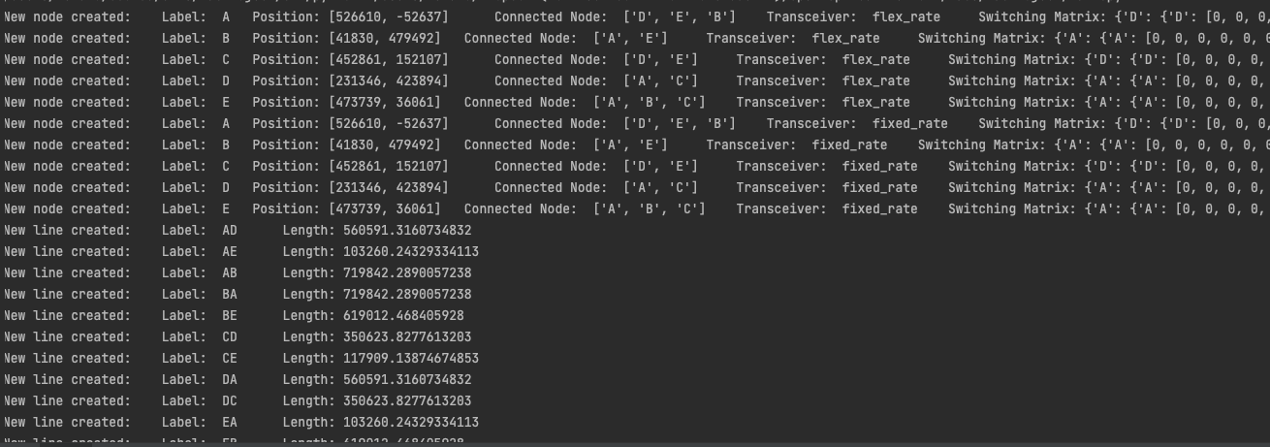
Network.js

Slide 9
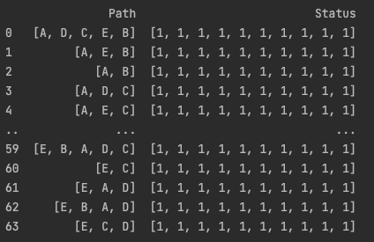
Network.js – Route Space
Knowing the physical topology of a network, defined a RWA algorithm, we can run it N times, returning the list of all possible routes, called routing space

Slide 10
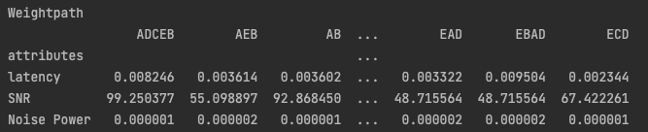
Network.js – Weightpath
By definition, a digital twin of the network is a topology graph with weighted metrics. So, we can create a data struct which is in charge to keep those metrics: SNR and Latency.

Slide 11
Network.js – Weightpath
Fields are populated calling computeWeightedPaths() from main.js class.
This function for each path present inside the frame, calls “probe()” passing a Signal Information instance.
The difference between probe and propagate, is that probe is used just to retrive the metrics from the channel, so, this fun will not change the switching matrix.

Slide 12
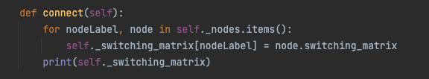
Network.js – Switching matrix
Switching matrix for the single node are provided by the json in the network topology. These are copied in as single dict in network class

Slide 13
Network.js – Methods
Some of methods are called from the main.py, others are used internal to computer the best path, propagate lightpath and keep the data struct updated.

Slide 14
Network.js – createAndManageConnections()
This method is called by the main.py and receives a traffic matrix and a label that can be «snr» o «latency» in order to choose the best path.
It tries to allocate all the possible connections reading the traffic matrix and calling stream() methods.
After that all the connections have been created (or the network is considered saturated), all the metrixs are collected, connections are deallocated and metrixs are returned.

Slide 15
Network.js – stream()
Stream methods receives a connection and a label:
Looks for best path, according to the label, and select path and channels. If no free channel is found, -1 is returned
Calls calculate_bit_rate() passing lightpath and transceiver type. If the path supports the minimum bitrate, bitrate and GSNR are saved, otherwise returns 0.
Calls propagate(), passing signal, path and bitrate. At the end, bit rate and GSNR are returned.

Slide 16
Network.js – propagate()
The main work of this method il to call propagate method for each node in the given path.
Other important work of this method is to set the channel on the given path as busy: this is done updating the switching matrix setting 0 and on the channel and on the the adjacent two.

Slide 17
Classes
Main.py
Network.py
Node.py
Line.py
Connection.py
SignalInformation.py
LightPath.py

Slide 18
Node class
Node class represent a ROADM abstraction. Node, are initially read from json file in main class, then, a dict containing all the information is passes in the network class.
A list of node objects is created into the network class

Slide 19
Node – propagate()
The main method inside the node class is ”propagate()”. This method is called into the network’s propagate, for each node in the path.
The purpose of this method, is to correct set up the launch power, add signal latency and GSNR, and set the channels busy.

Slide 20
Classes
Main.py
Network.py
Node.py
Line.py
Connection.py
SignalInformation.py
LightPath.py

Slide 21
Line class
Line class represent a OLS (optical Line System) abstraction. The main attributed are computed and setted into the network class:
Length: is computed with the position of two connected nodes
N amplifiers: is computed with using the length; we put an amplifier each 80km
Bit rate: is setted the the “computedBitRate” network’s method

Slide 22
Line class
We also used some constants:
Gain =16dB
Noise Figure = 3dB
α_{db} = 0.2dB/km
|β₂| = 2.13 e−26 ps2/km;
γ= 1.27(Wm)⁻¹;

Slide 23
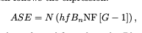
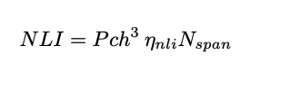
Line methods:
latency_generation(): uses the line length and the speed of light to compute the latency in the OLS
ase_generation(): represent the Amplified spontaneous emission f is fixed to 193.414 THz (C-band center), Bn is the noise bandwidth fixed to 12.5 GHz, NF and G are the amplifier noise figure and gain, respectively.
nli_generation(): Nonlinear interference
optimized_launch_power(): which implement LOGO
(Local Optimization Global Optimization)

Slide 24
Classes
Main.py
Network.py
Node.py
Line.py
Connection.py
SignalInformation.py
LightPath.py

Slide 25
Connection class
Connection class contains all the attributes about the connection
Input
Output
signal_power
Latency
Snr
bit_rate

Slide 26
Classes
Main.py
Network.py
Node.py
Line.py
Connection.py
SignalInformation.py
LightPath.py

Slide 27
Signal Information class
SignalInformation class contains all the attributes about the signal
Signal power
Noise power
latency
path

Slide 28
Lightpath class
Lightpath inherit from Signal informations and add:
Channel
Symbol Rate fixed to 32GHz
frequency spacing fixed to 50 GHz

Slide 29
2. Network Topology

Slide 30
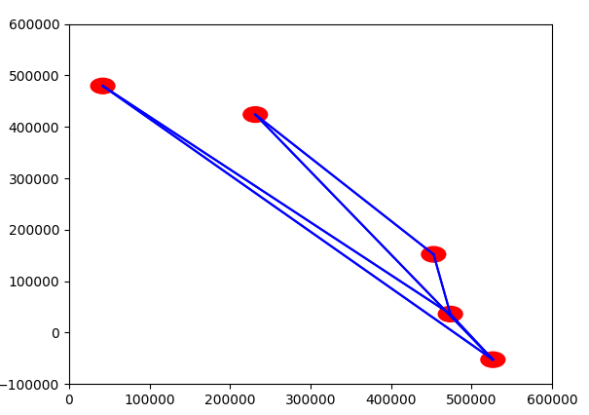

Slide 31
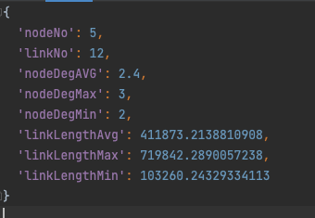
Network metrics
Black

Slide 32
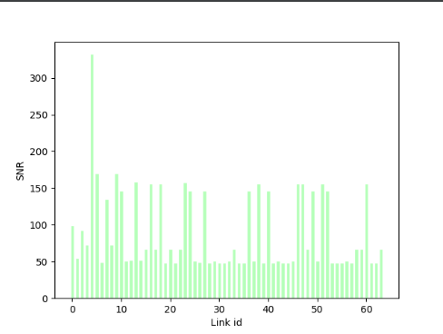
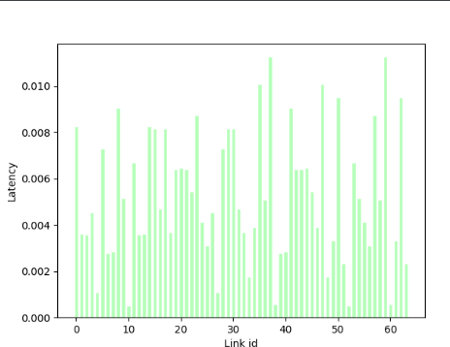
SNR and Latency over paths
Black

Slide 33
3. Monte Carlo Analysis
Single Traffic Matrix Scenario

Slide 34
How many runs?
First, we need to understand how many runs in the Monte Carlo analysis we need in order to have a significant results.
We plotted the main metrics in histogram, and we compare the result for different numbers of run.

Slide 35
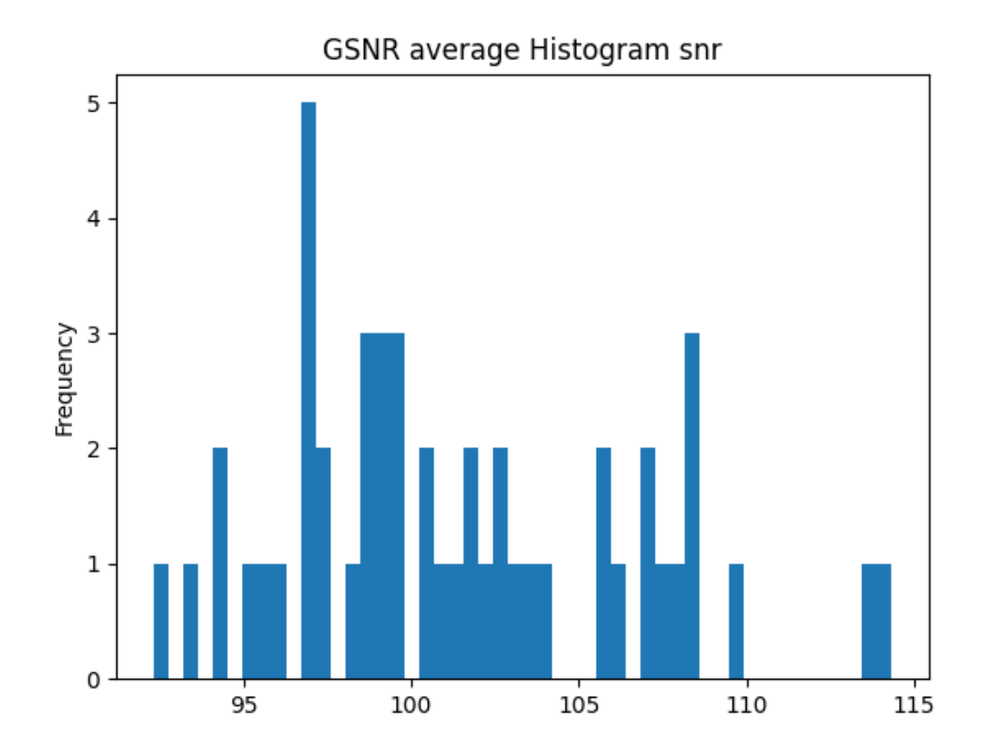
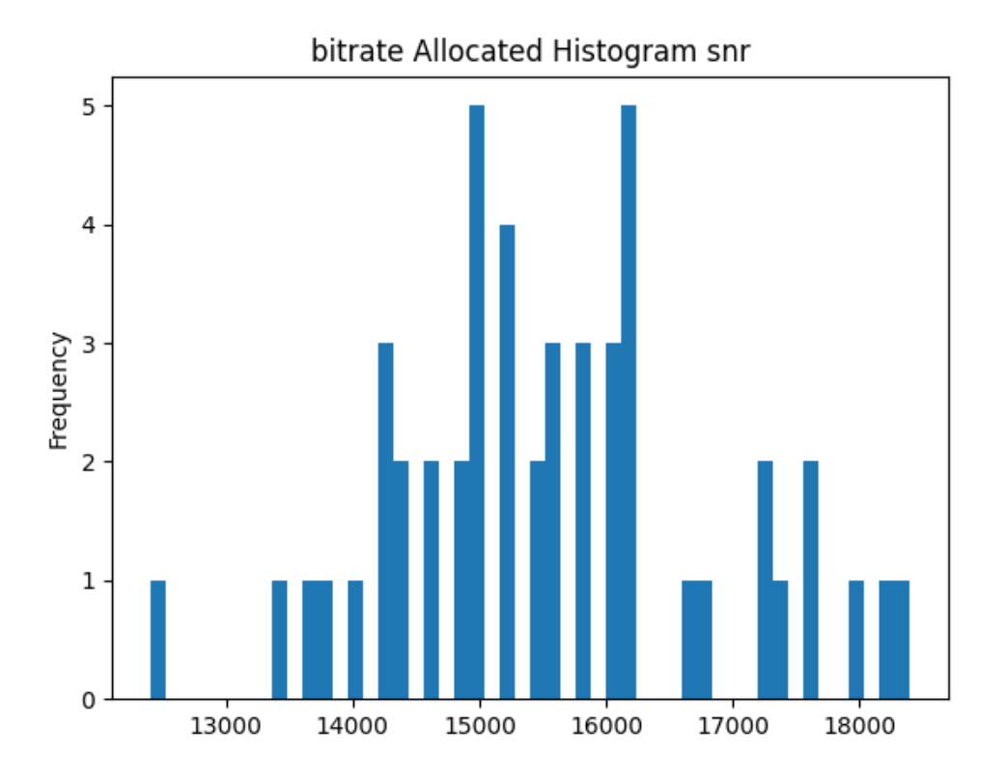
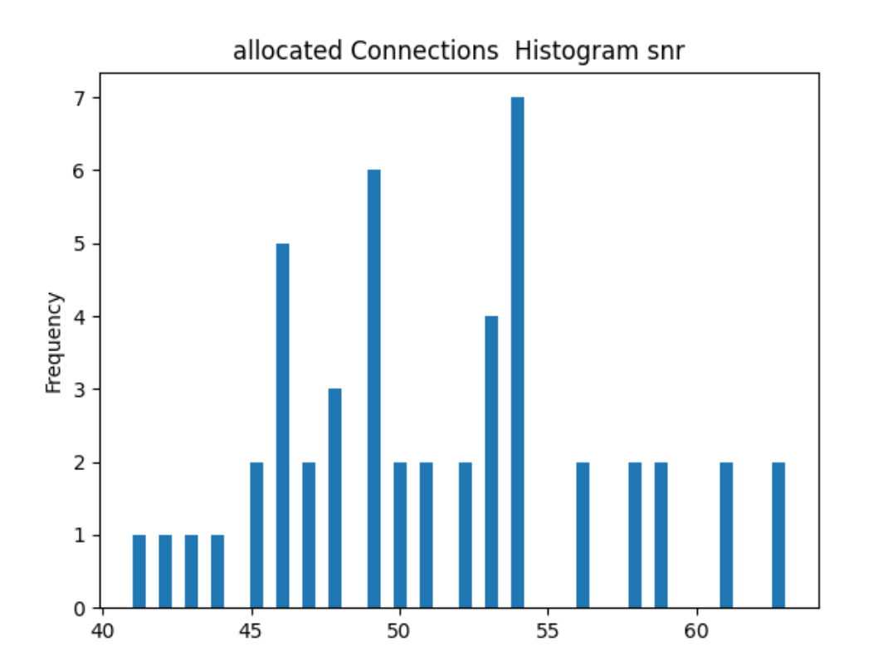
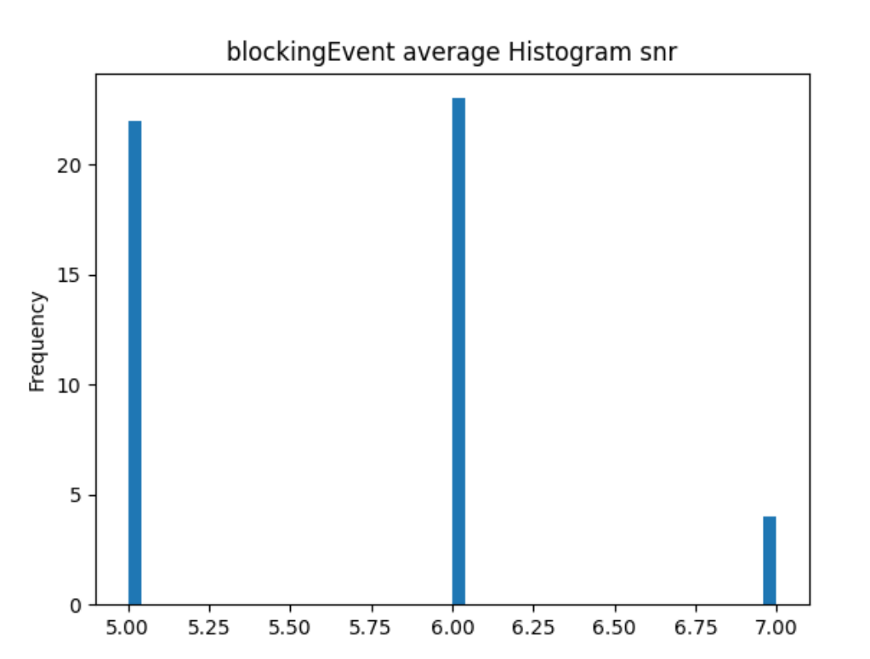
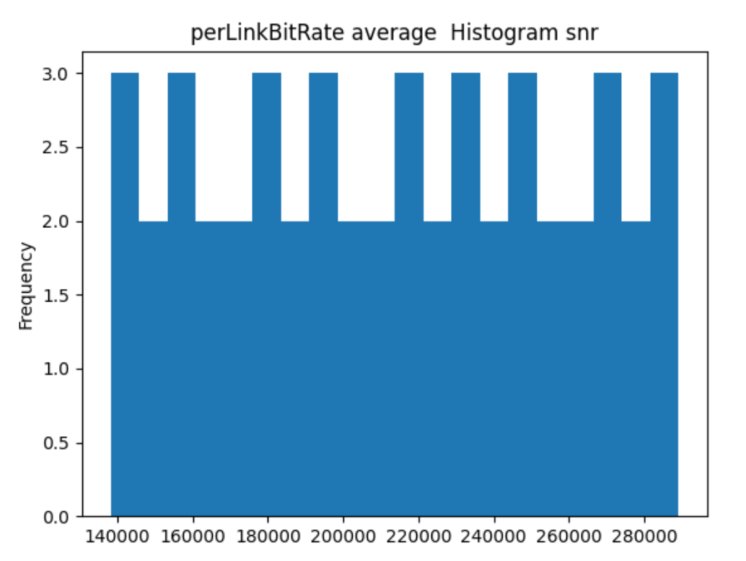
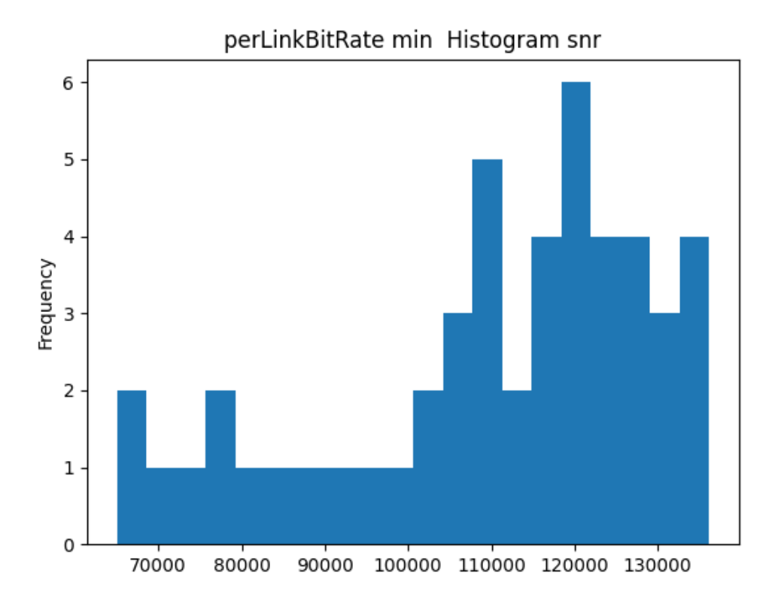
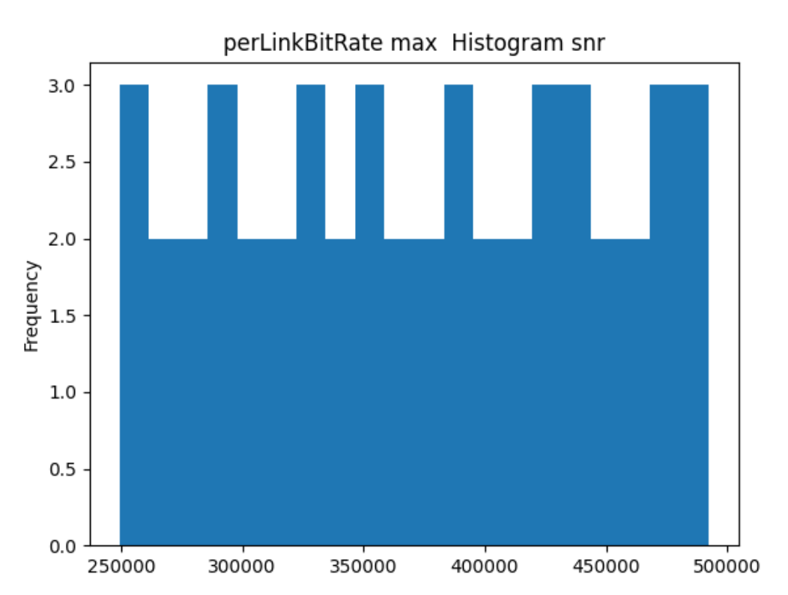
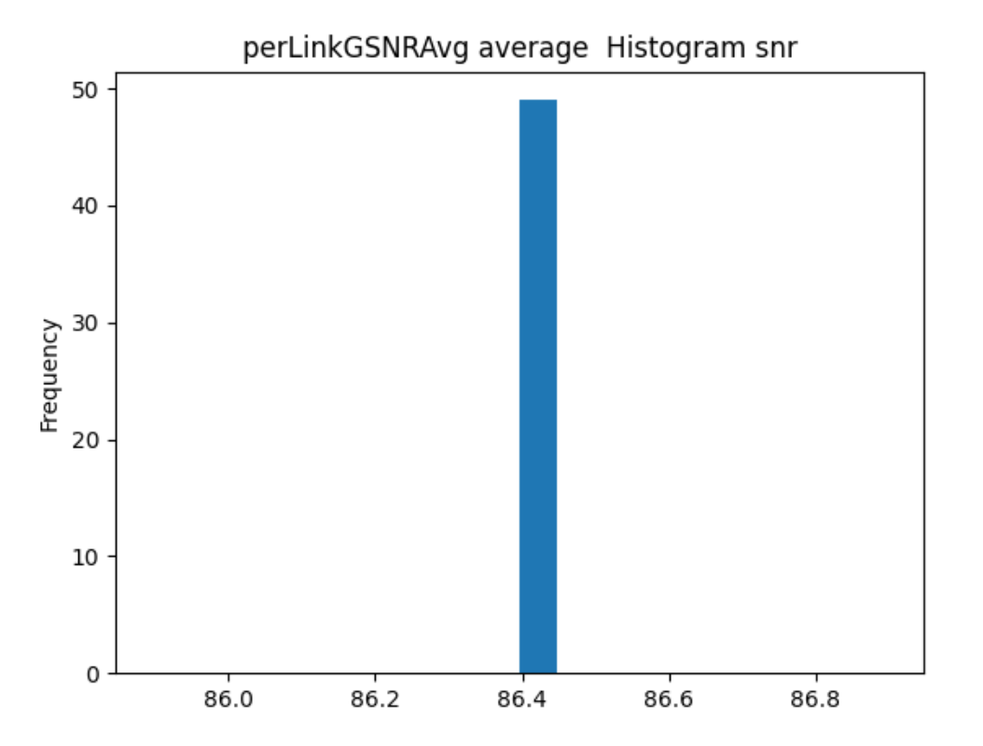

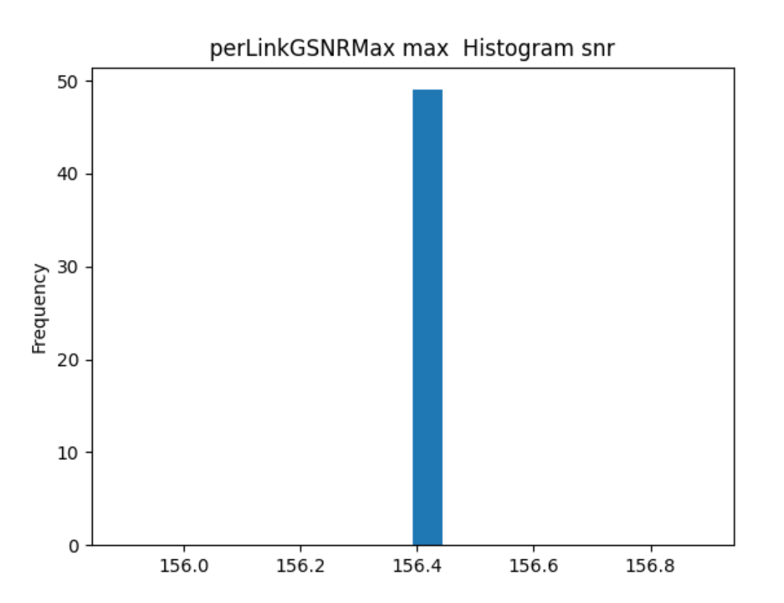
50 runs, M=5, FOM = snr

Slide 36
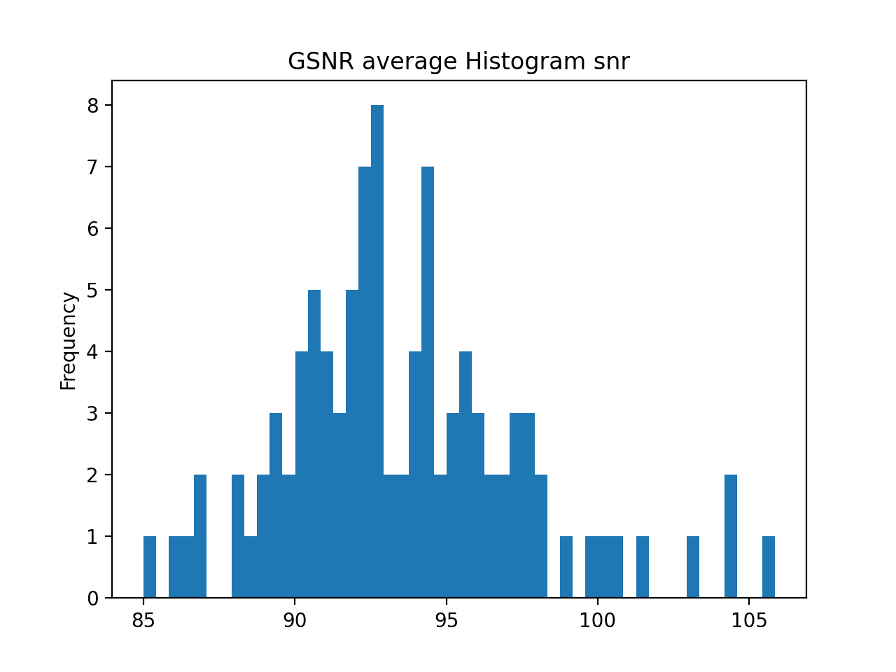
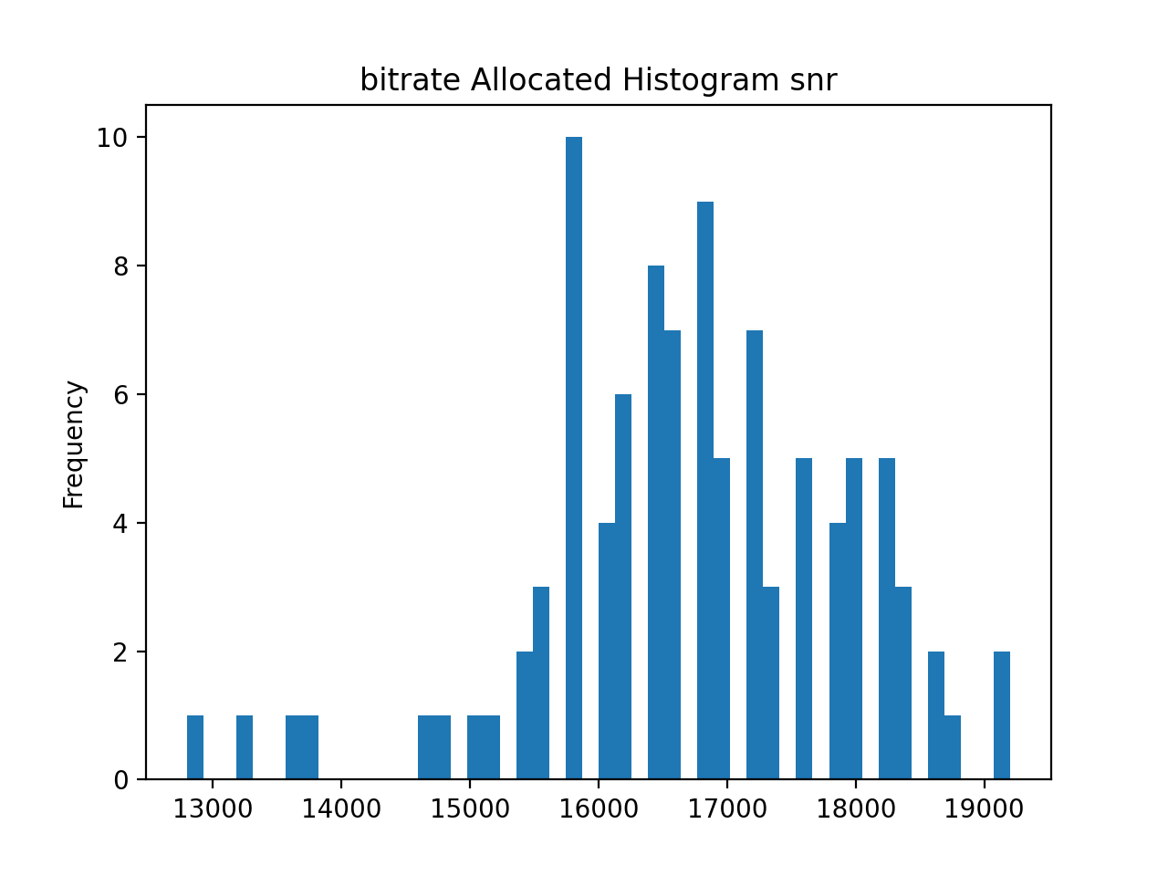
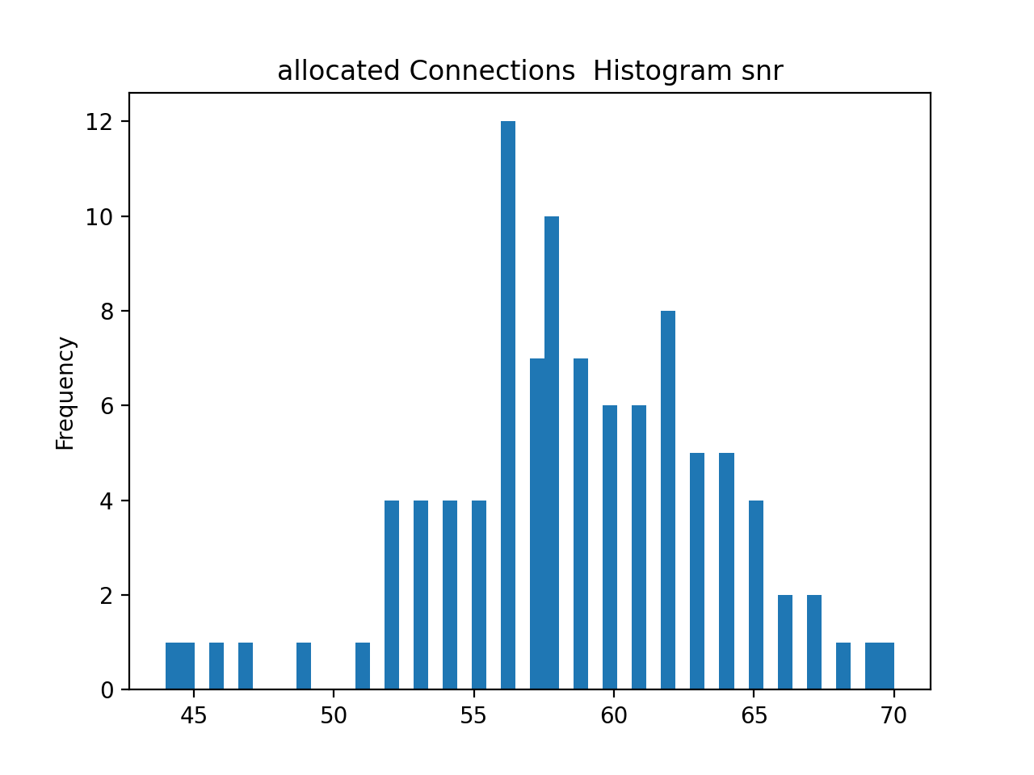
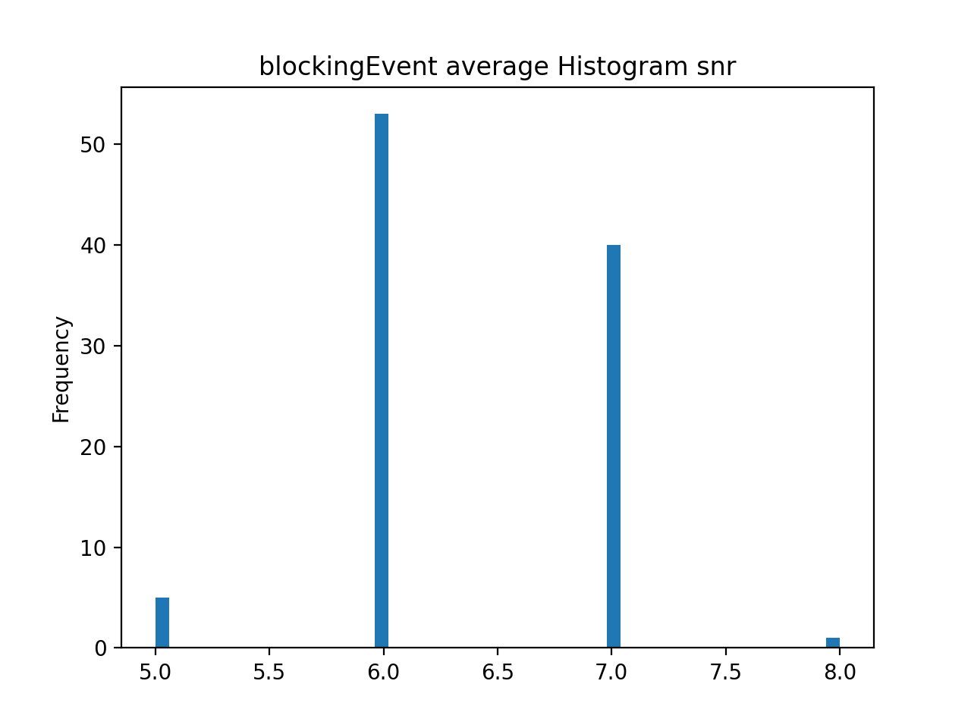
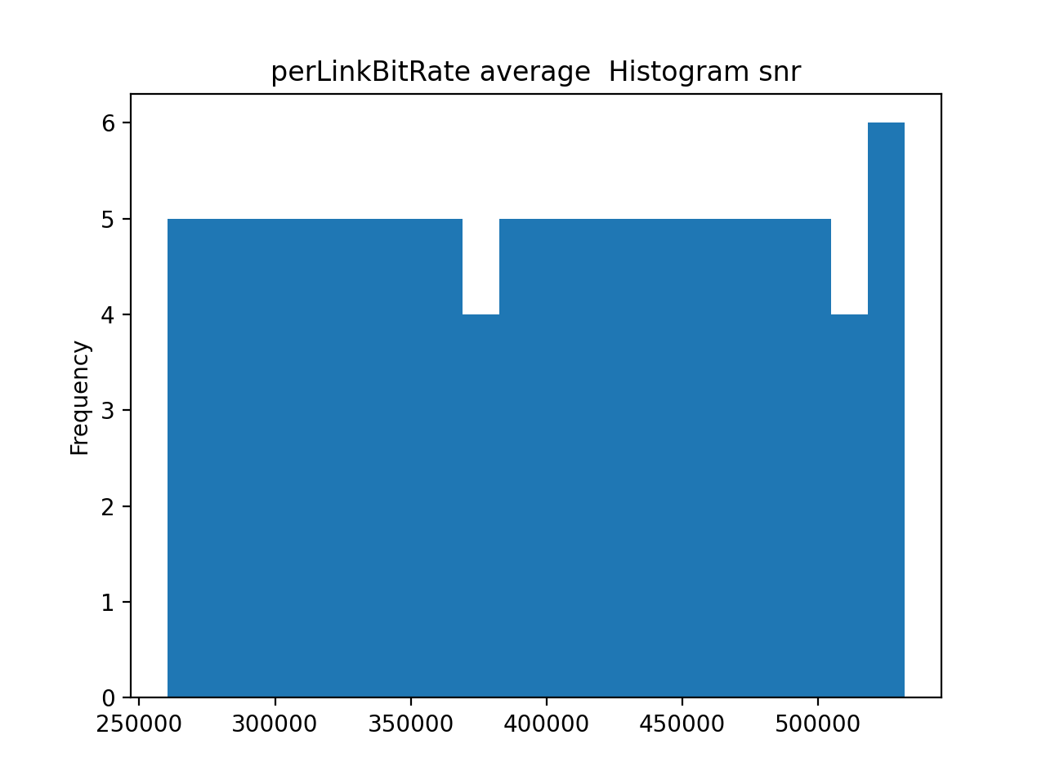
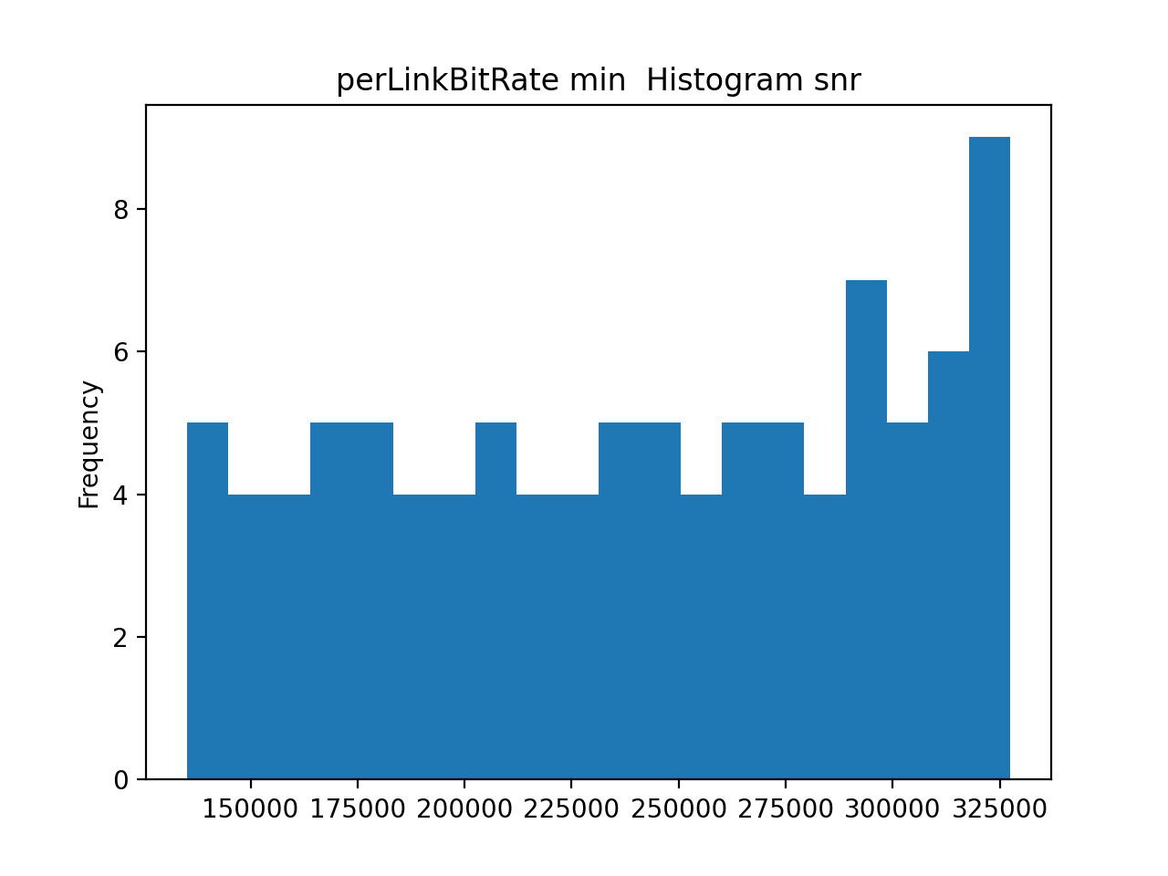
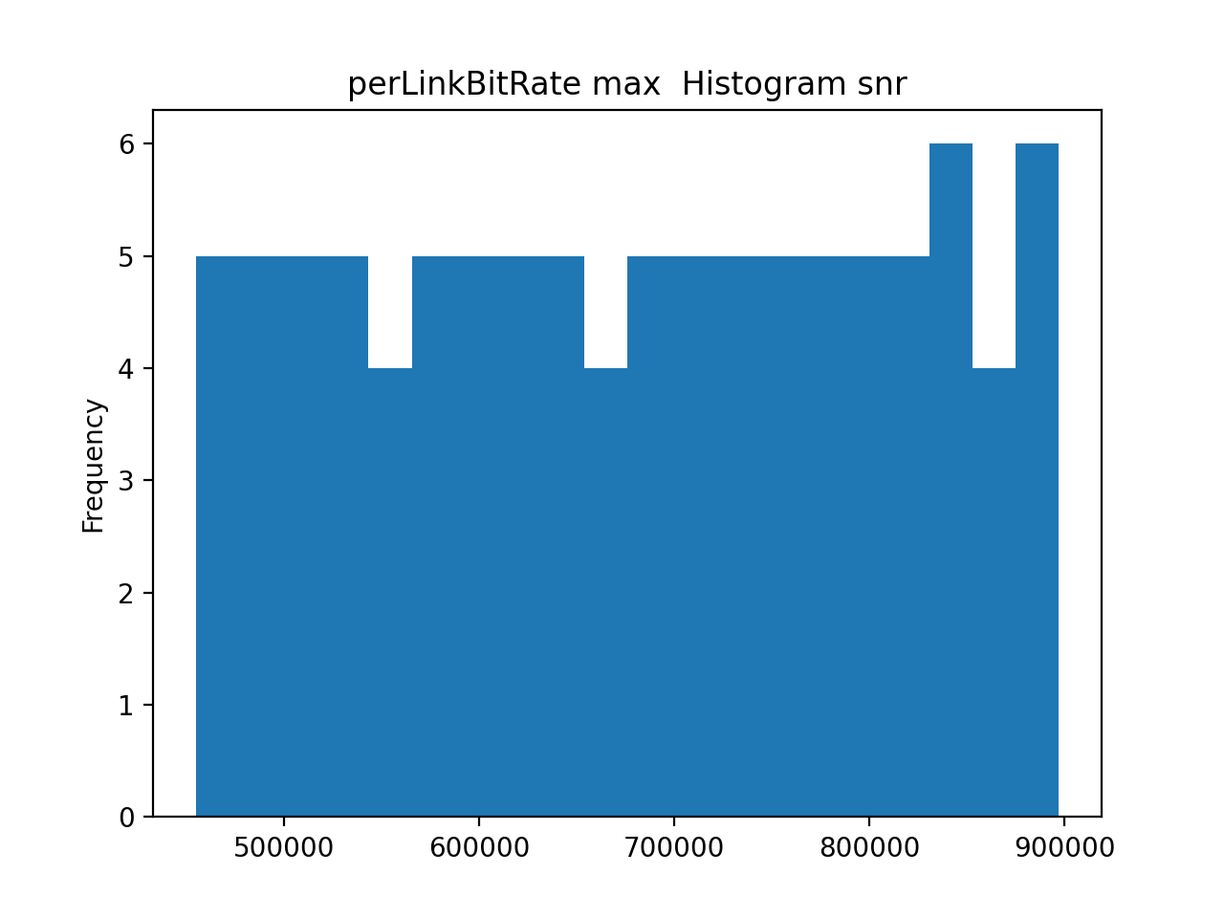
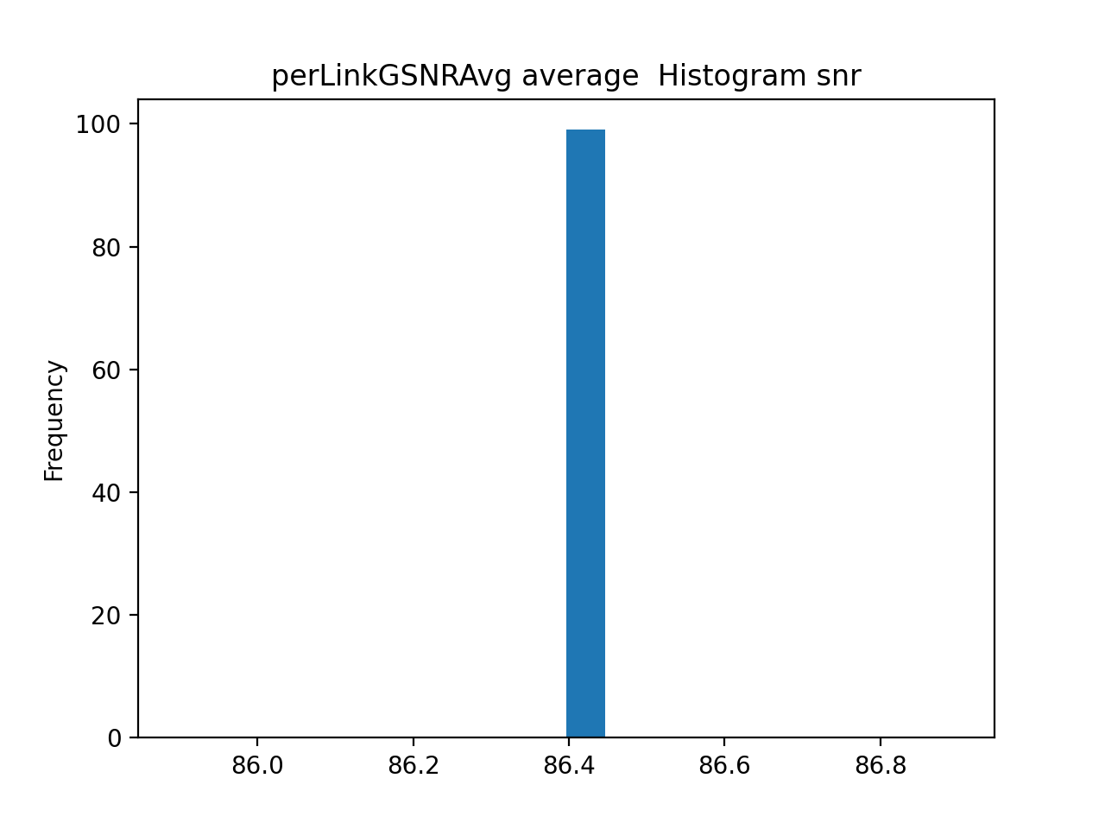


100 runs, M=5 FOM = snr

Slide 37
How many runs?
Some metrics shown a behaviour like a gaussian only with 100 run.
What about 200 runs?

Slide 38
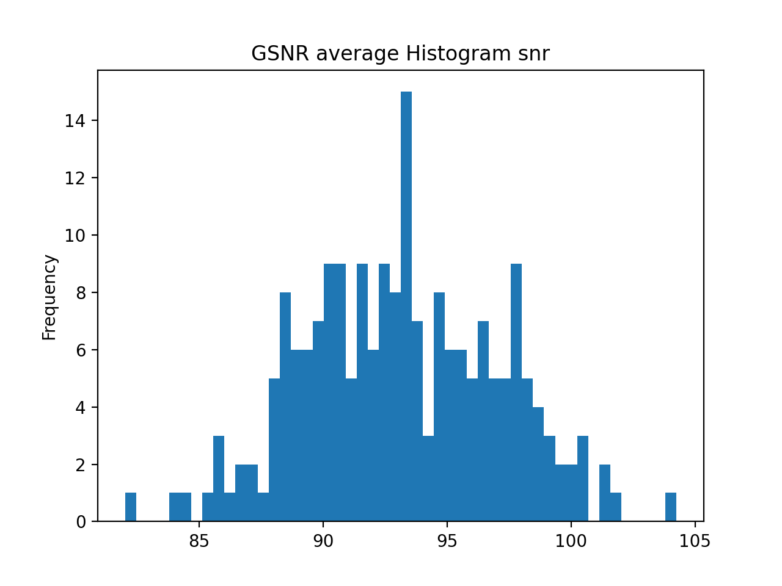
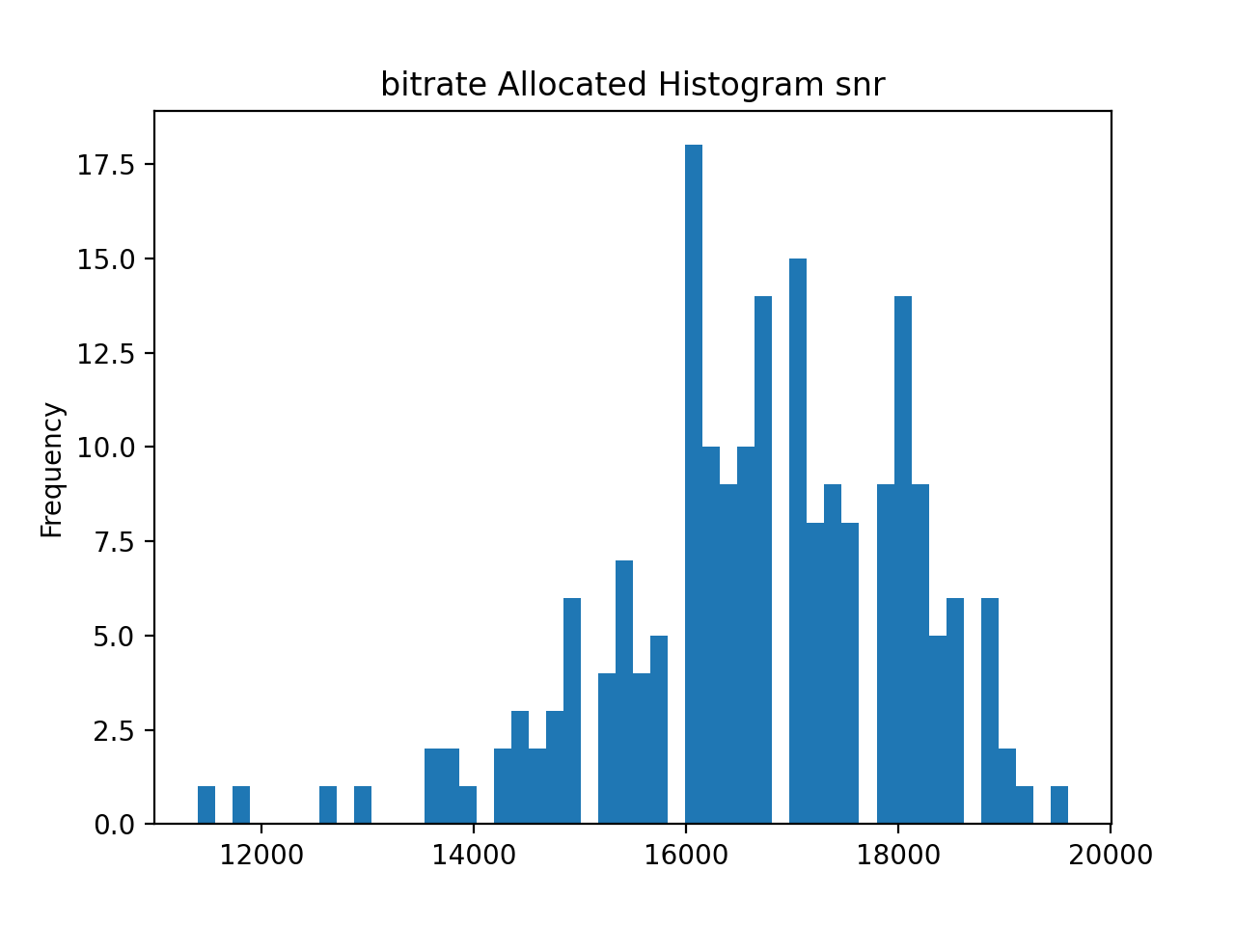
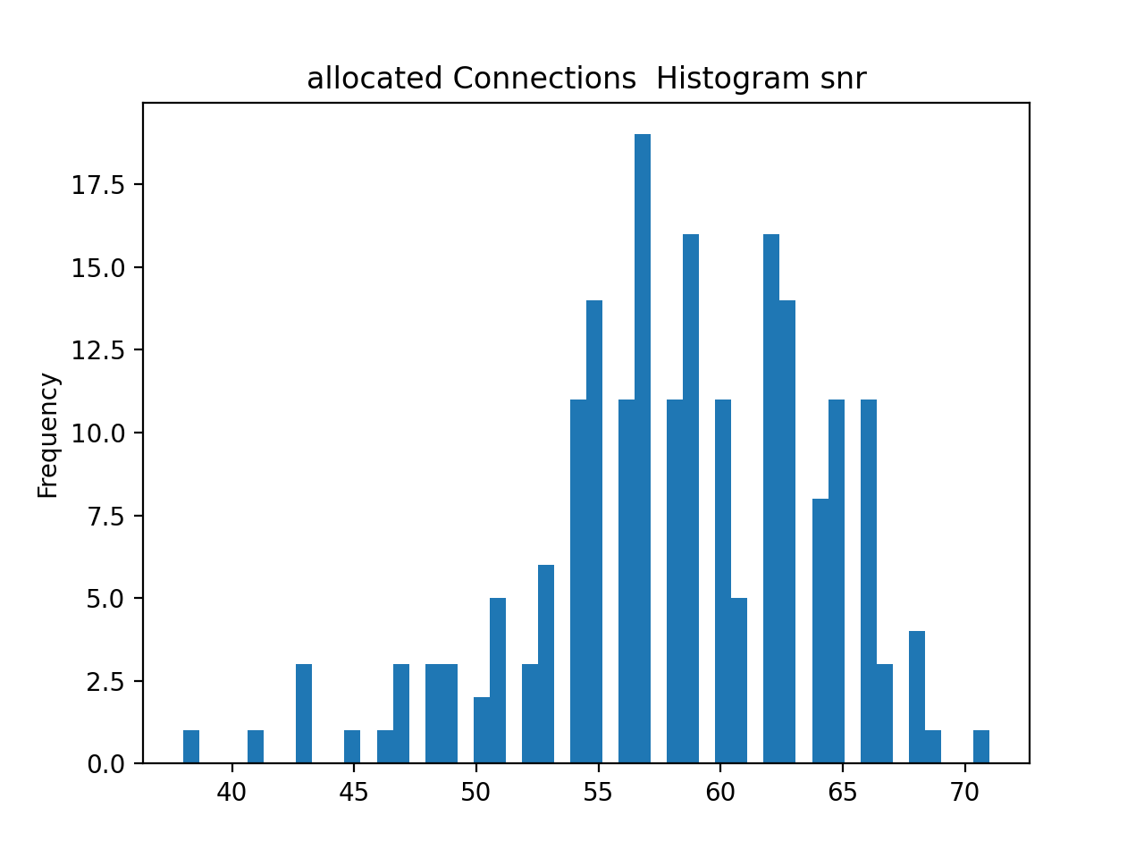
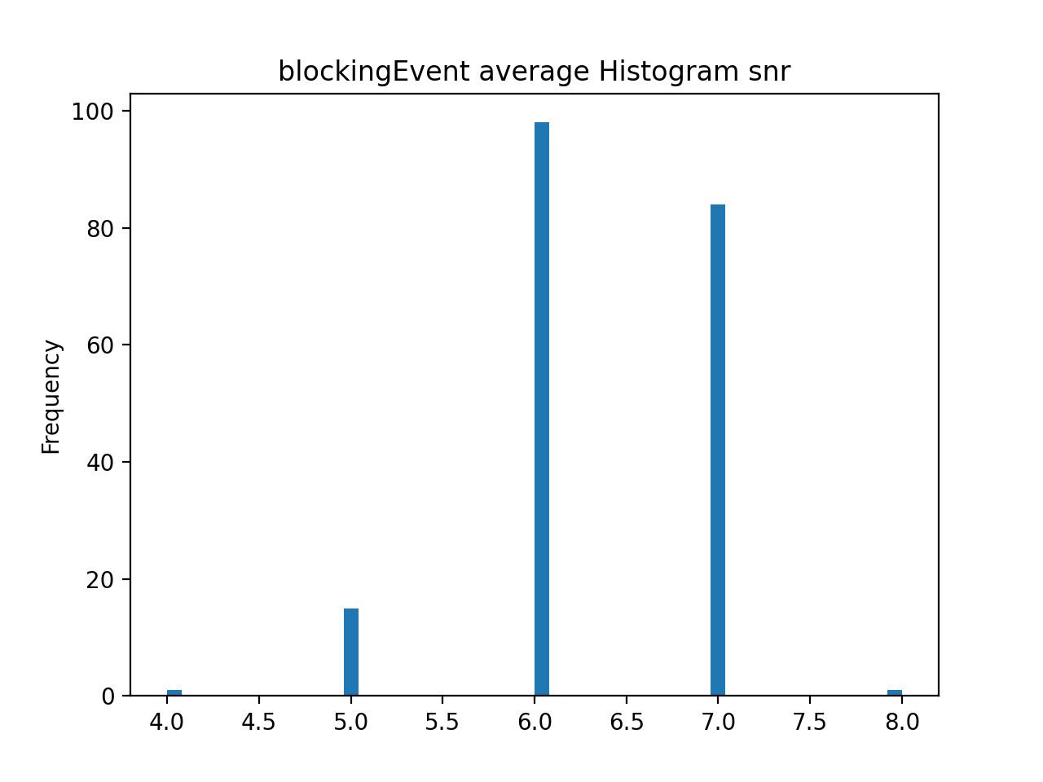
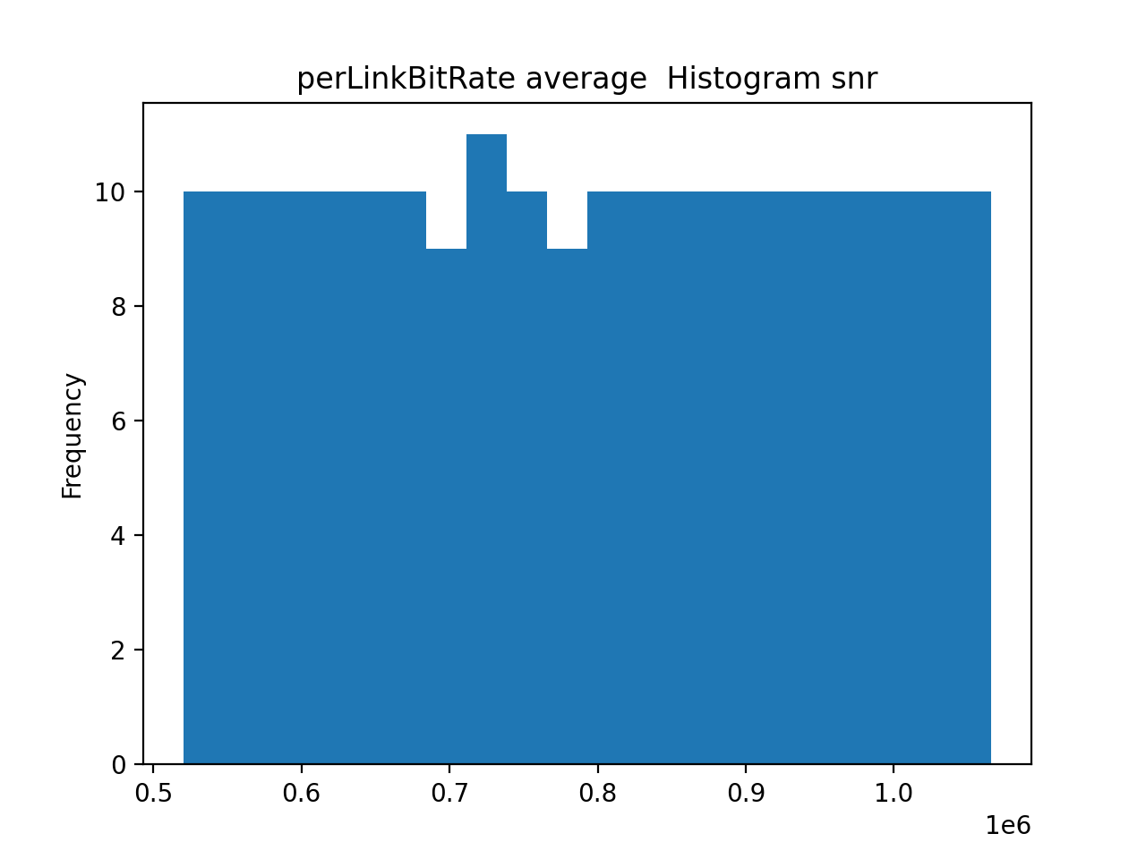
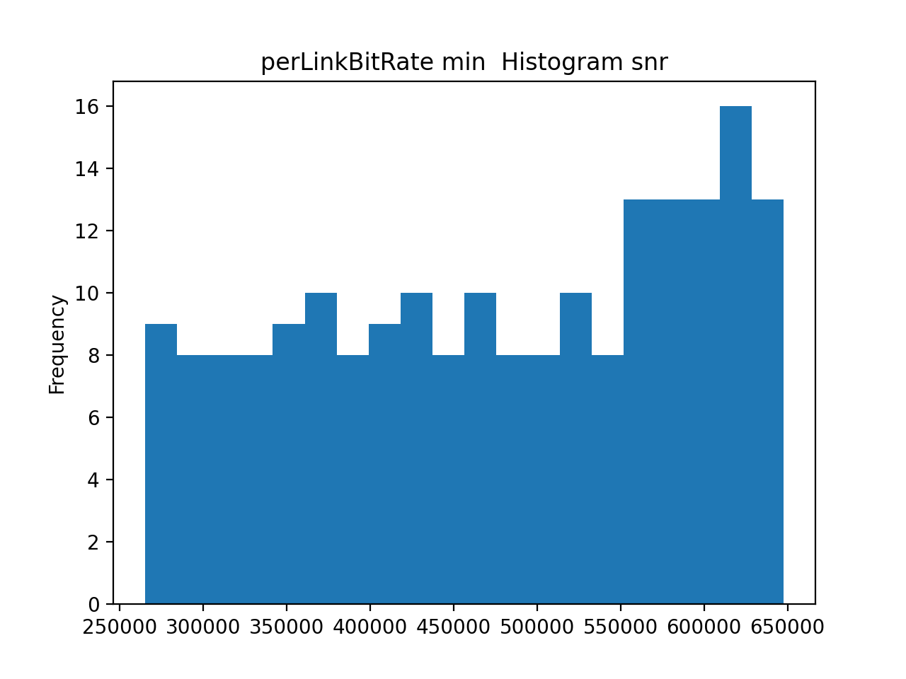
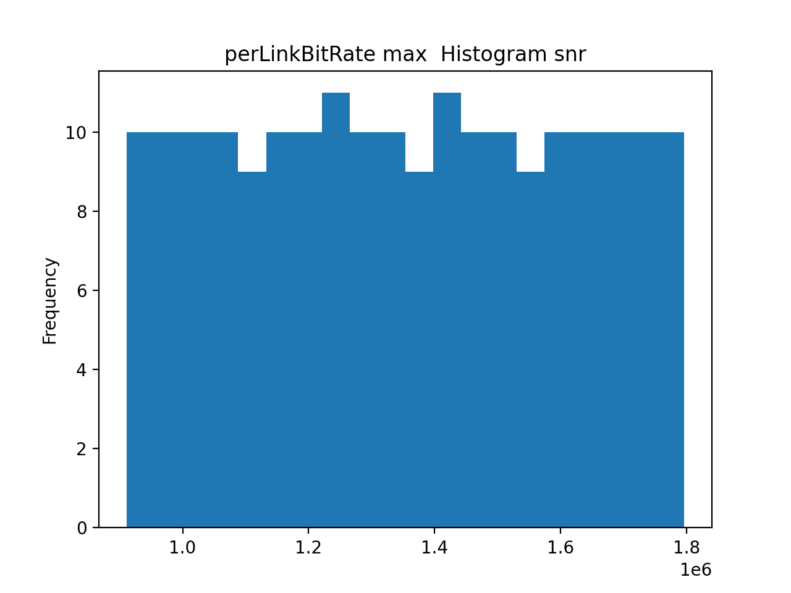
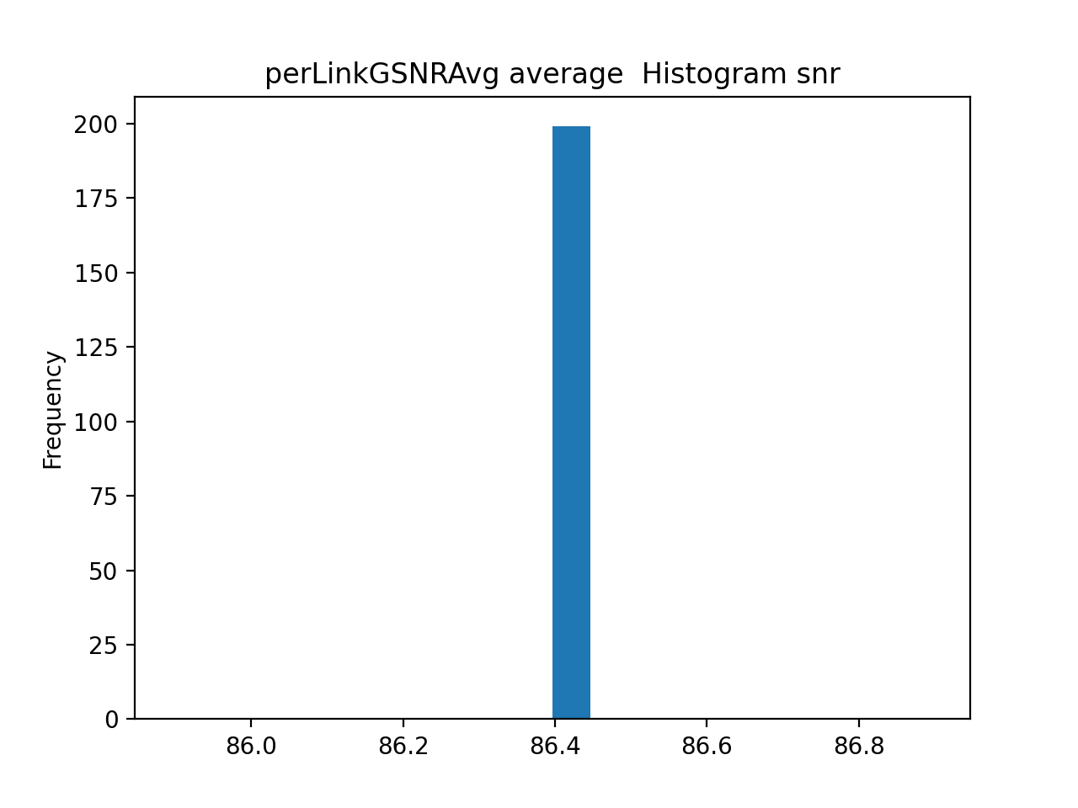


200 runs, M=10, FOM = snr

Slide 39
How many runs?
With 200 runs, gaussian do not changes too much, but, computation times doubles.
So, for next analysis we will run 100 the simulation.

Slide 40
Parameters in simulation
In the simulation we have a lot of possibility:
- 2 network (full, not full)
- 3 transceivers (fixed rate, flex rate, shannon)
- 2 FOM (latency o SNR)
12 simulation combination are possible, but not all will be presented, we will make evident the main difference

Slide 41
1
Simulation
Topology: full network topology
Transceiver: fixed rate
M: 5
Number of run: 100
FOM: latency

Slide 42
2
Simulation
Topology: not full network topology
Transceiver: fixed rate
M: 5
Number of run: 100
FOM: latency

Slide 43
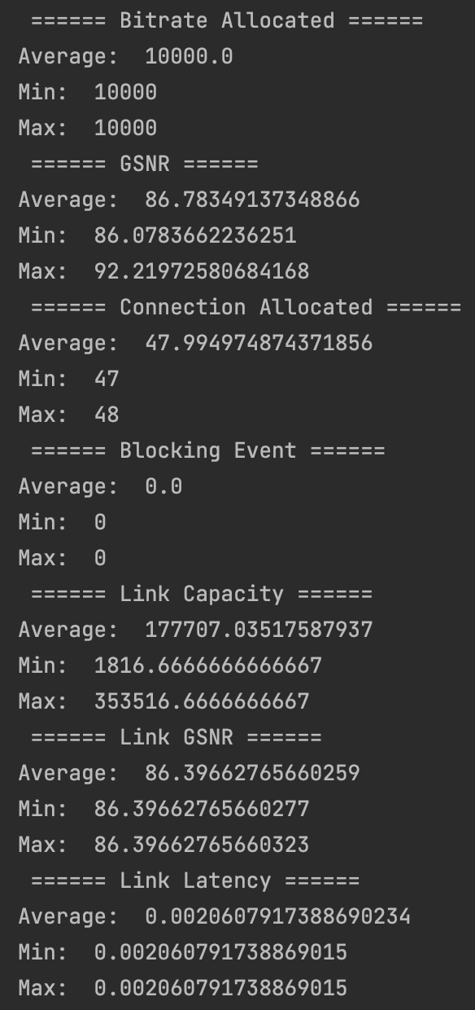
1
Simulation

Slide 44
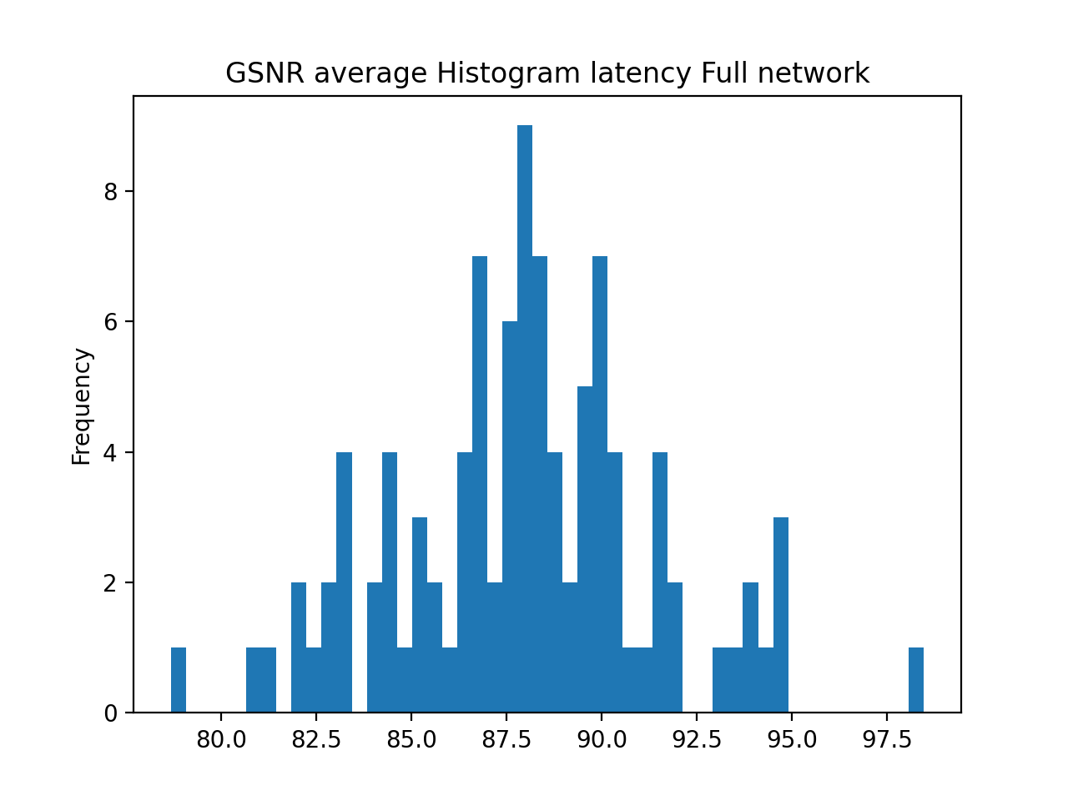
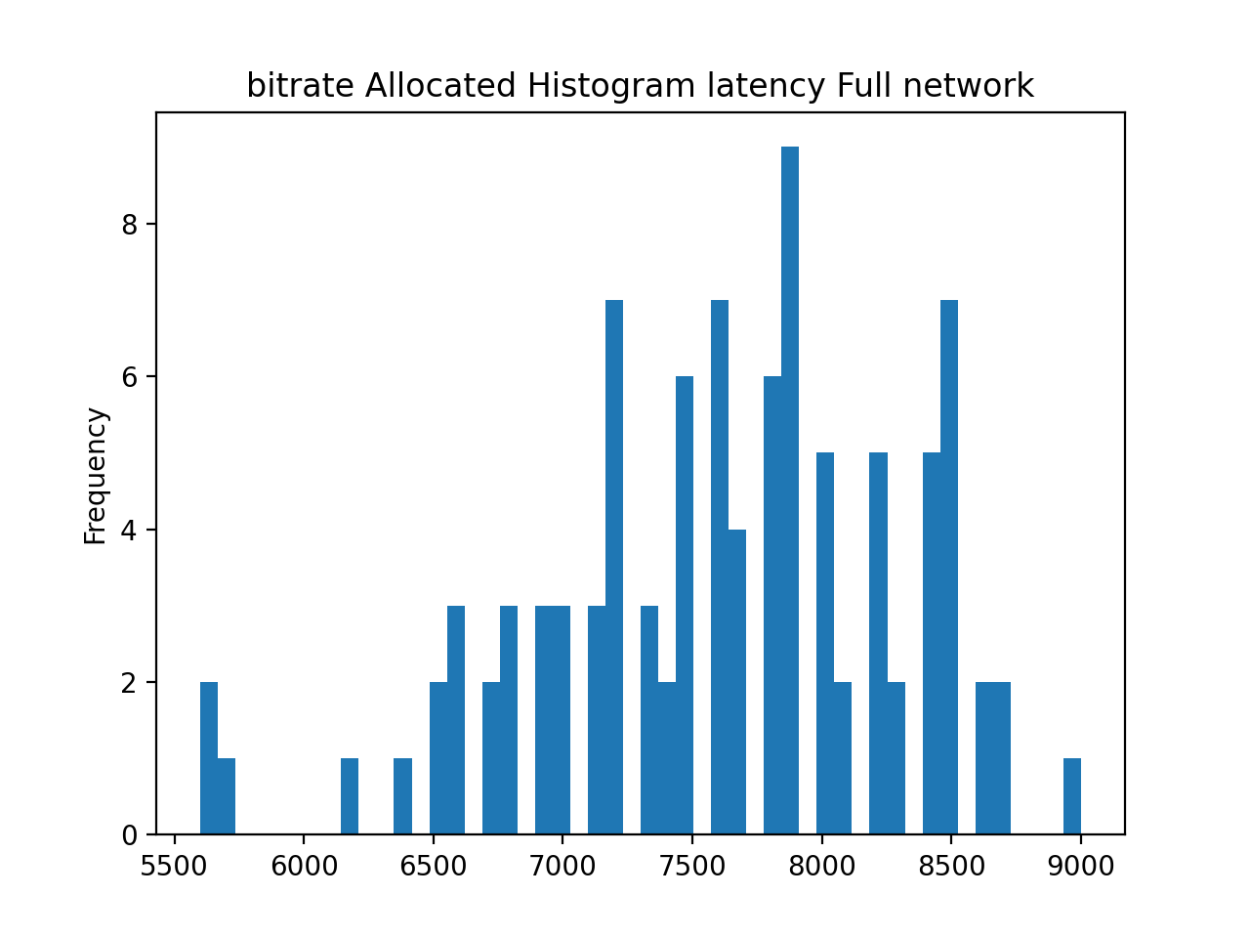
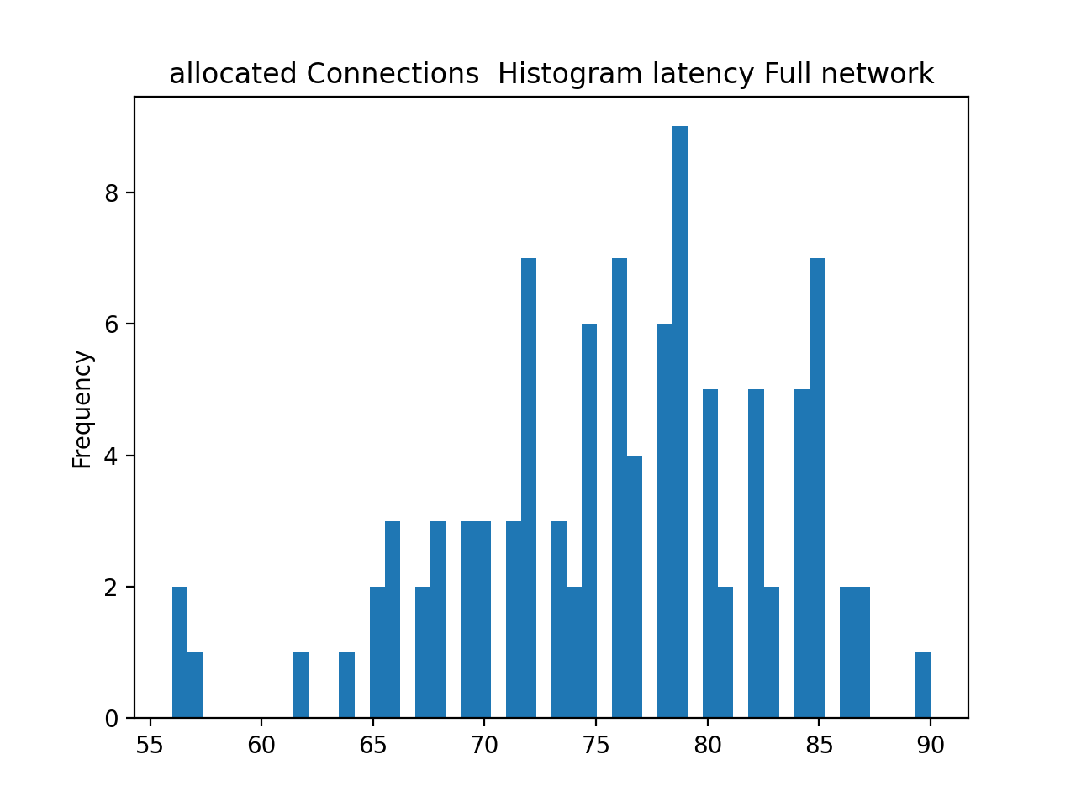
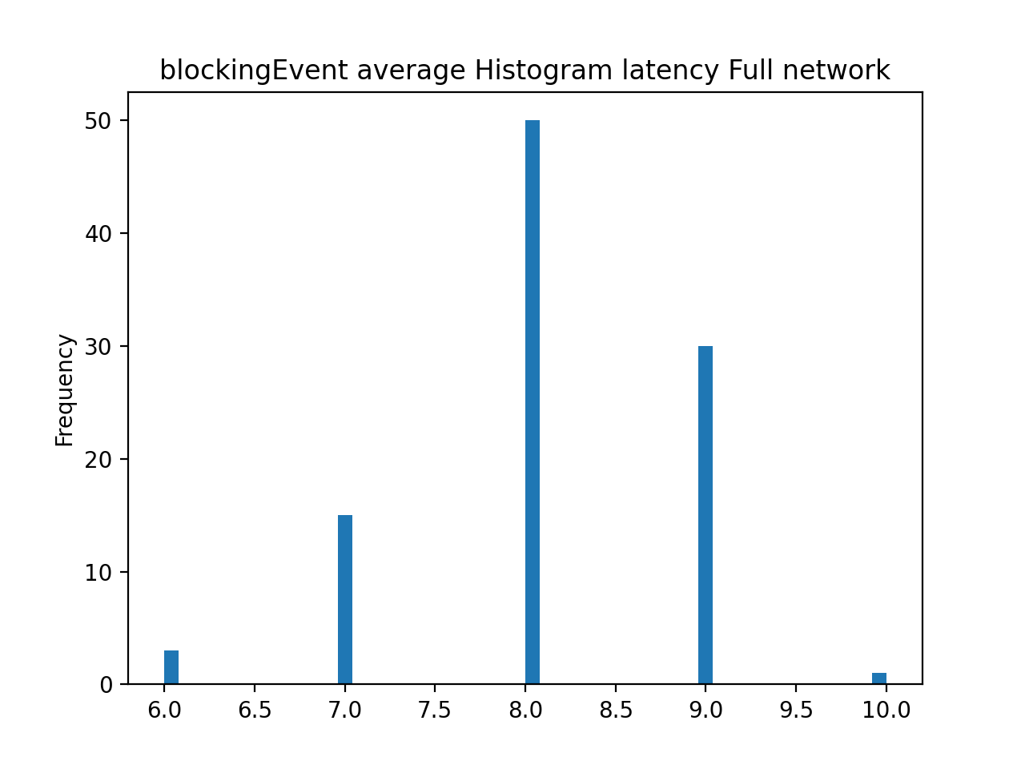
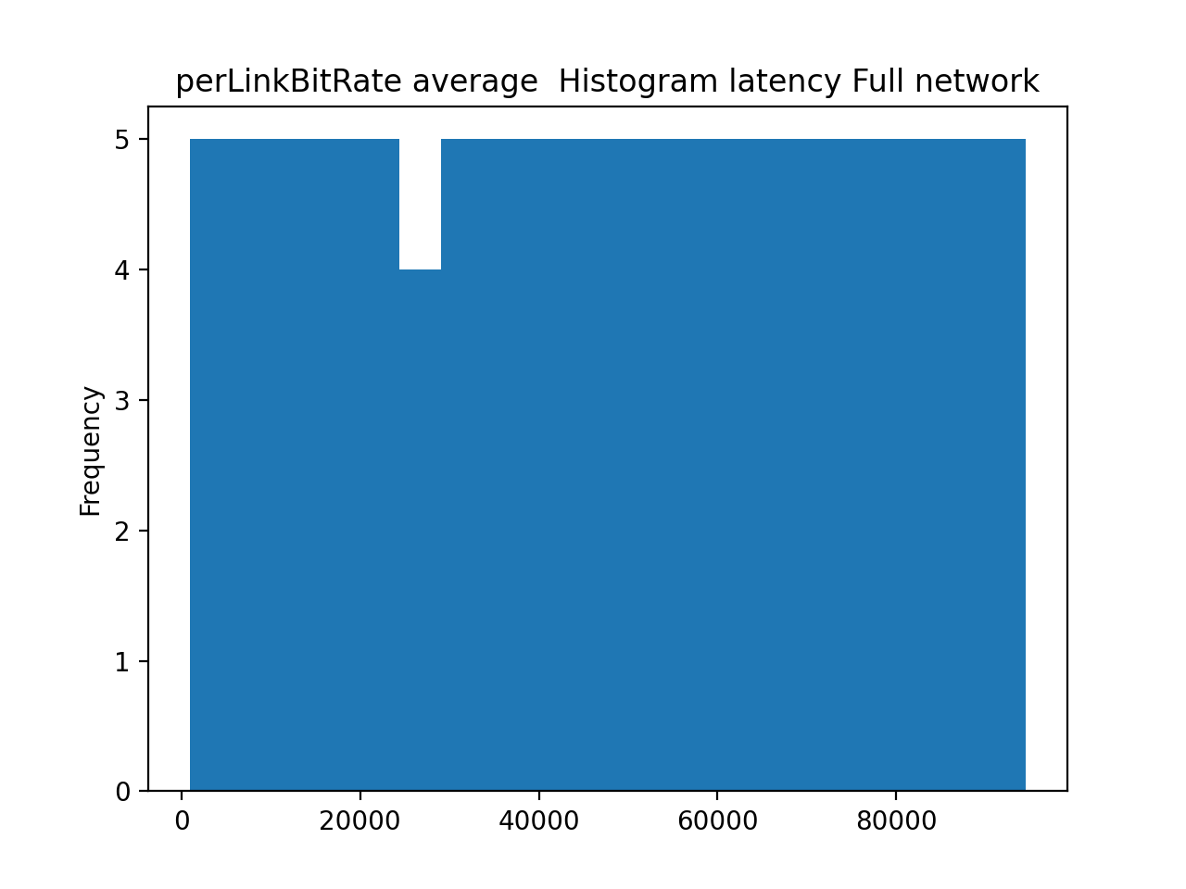
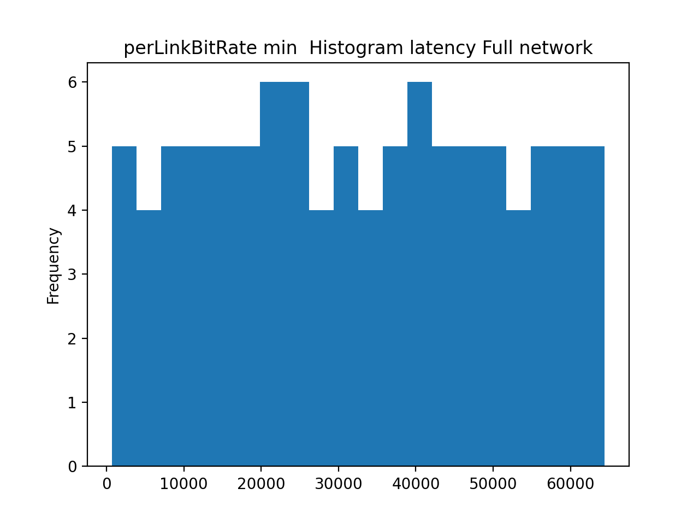
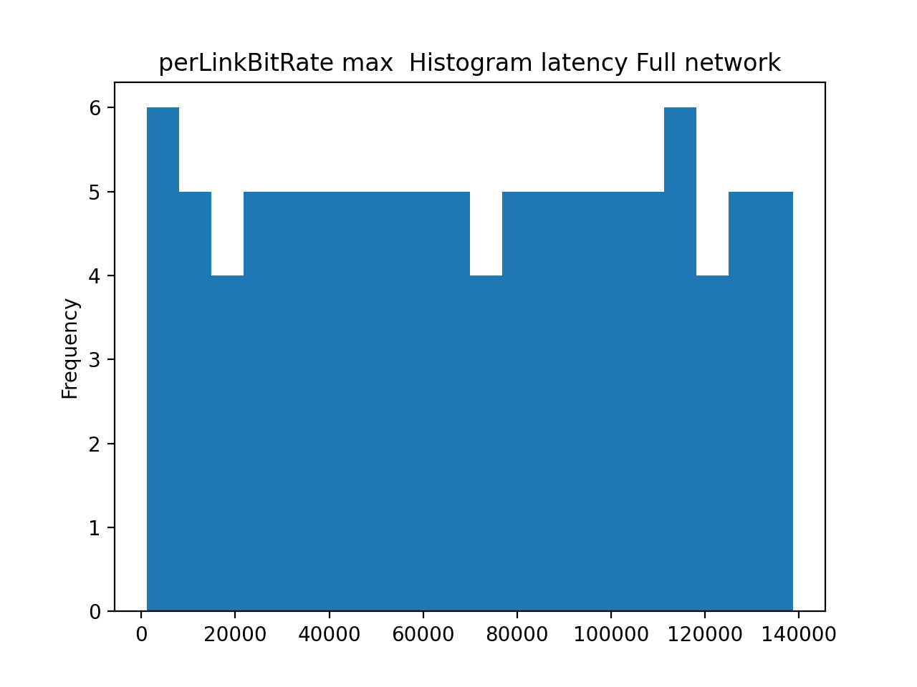
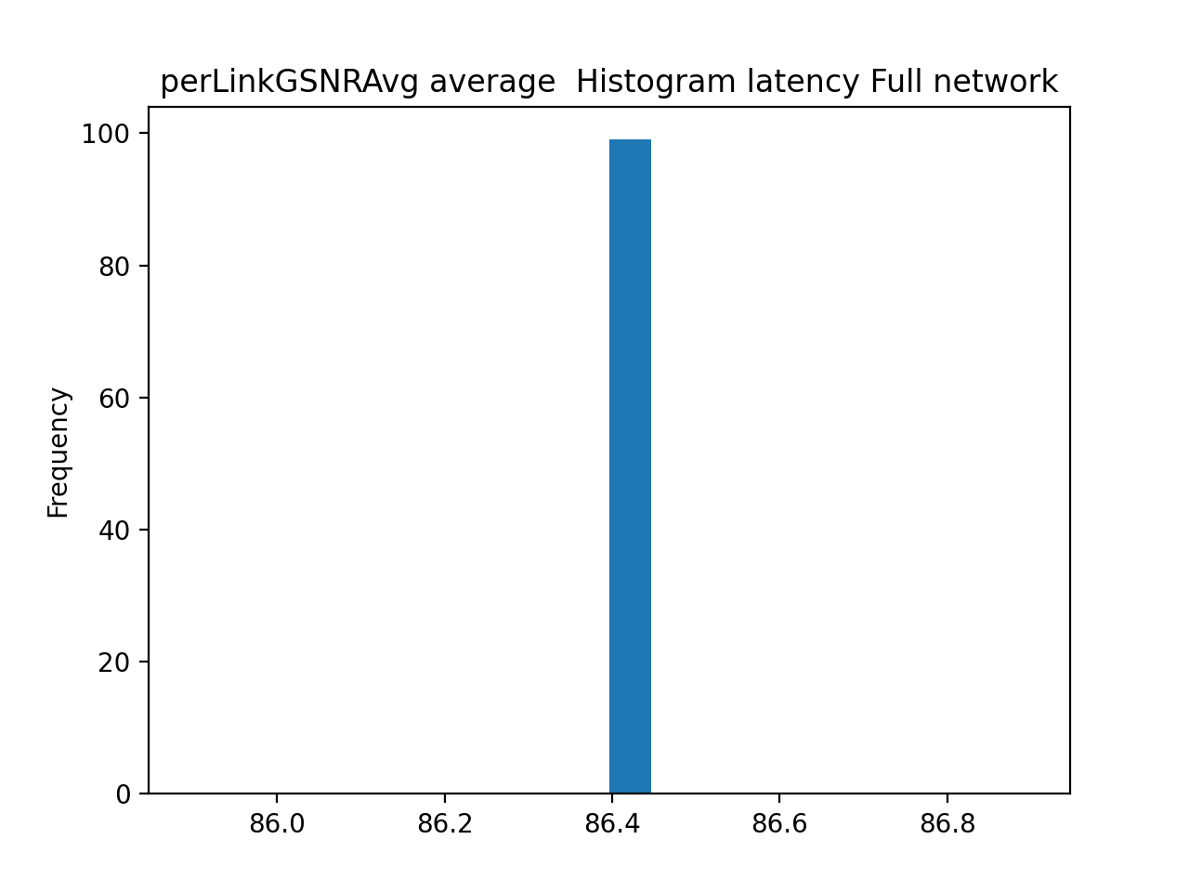
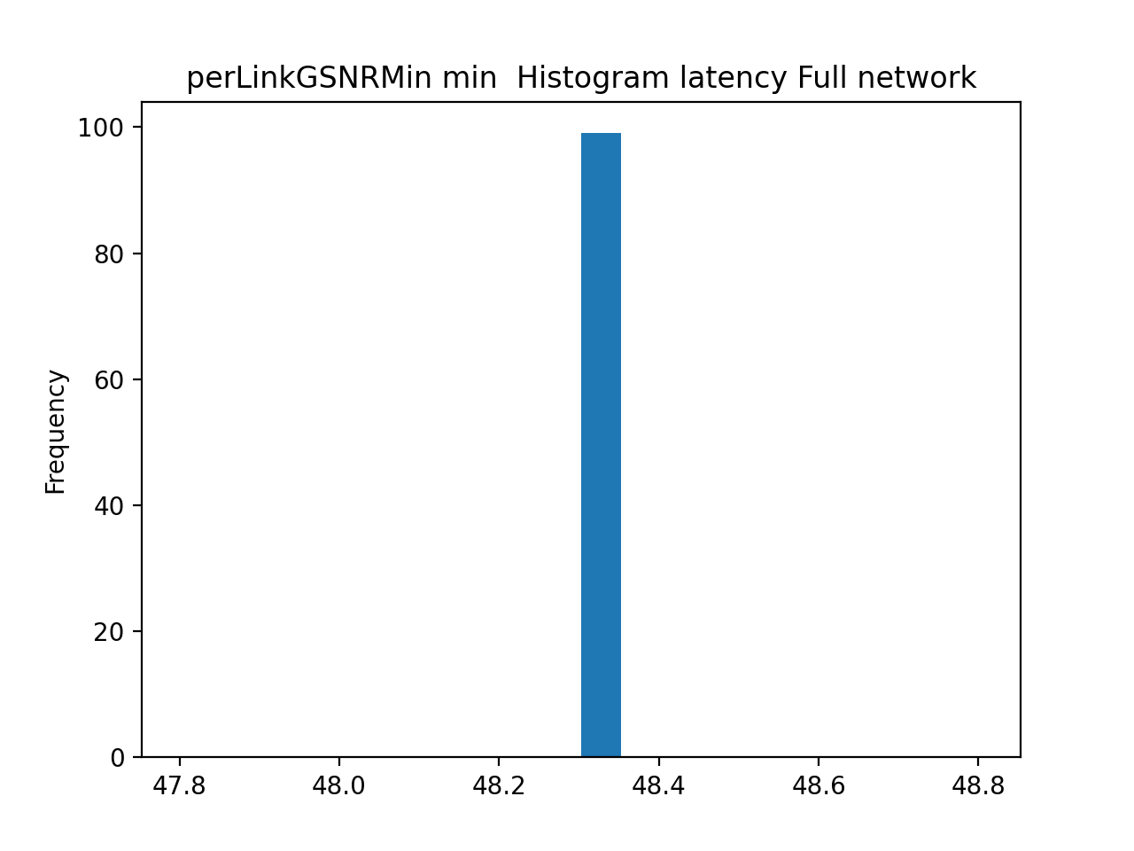

1

Slide 45
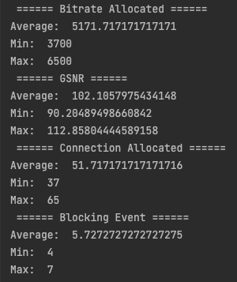
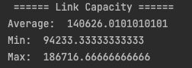
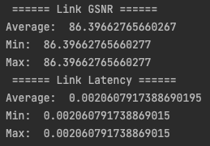
2
Simulation

Slide 46










2

Slide 47
Simulation difference
1
2
Less blocking event in full topology
More bitrate allocated in full topology

Slide 48
3
Simulation
Topology: full network topology
Transceiver: fixed rate
M: 10
Number of run: 100
FOM: latency

Slide 49
4
Simulation
Topology: full network topology
Transceiver: flex rate
M: 10
Number of run: 100
FOM: latency

Slide 50


3
Simulation

Slide 51







3

Slide 52


4
Simulation

Slide 53







4

Slide 54

3
Simulation difference
4
Flex Rate:
High bitrate allocated
Less blocking events
High capacity in links

Slide 55
4. Monte Carlo Analysis
Network congestion

Slide 56

Network congestion
In this simulation traffic matrix changes among the different runs.
This is a basic matrix which is multiplied for M, where:
1≤ M ≤ 50
This simulation will give us the possibility to understand the saturation point, and what we can do to allocate more connection before the network will saturate

Slide 57






Network congestion – fixed rate
Full topology
Not Full topology

Slide 58






Network congestion – flex rate
Full topology
Not Full topology

Slide 59






Network congestion
fixed
flex
shannon
Full topology
Not Full topology

Slide 60






Network congestion - GSNR
fixed
flex
shannon
Full topology
Not Full topology

Slide 61


Network congestion – Bitrate
fixed
flex
shannon
Full topology
Not Full topology

Slide 62
Thanks!

